Slide 1
Towards GFem

Slide 2
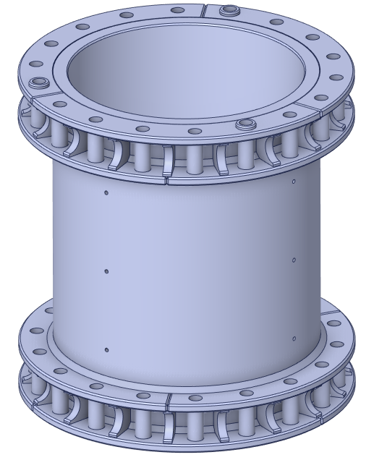
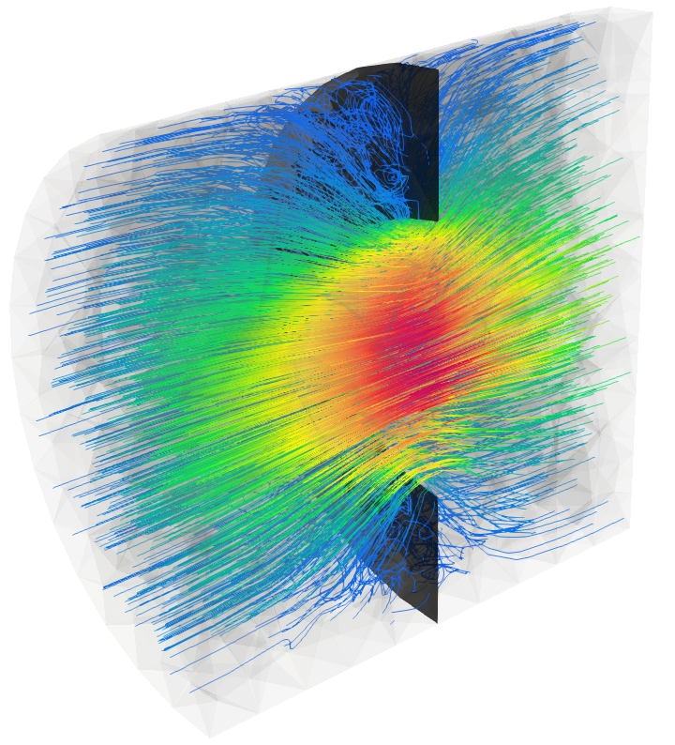
Introduction
Extend NeoPZ to incorporate GFem approximations
NeoPZ basic structure
GFem computational mesh
GFem computational element
Darcy simulation
Elasticity simulation

Slide 3
Extend NeoPZ with Gfem spaces
GFem can be viewed as a strategy for enriching approximations spaces
The H1 background approximation is unchanged
The geometric map is unchanged
One needs to add functions

Slide 4

The NeoPZ environment
PZ
Geometric Map
Approximation Space
Variational Statement
System resolution
H1
Hdiv – Hcurl
Discontinuous
Multi physics
H refinement
Blended map
Refinement patterns
Systems of differential equations
Linear and nonlinear
Matrix storage patterns
Resolution methods
Substructuring
Multigrid
Pre conditioning
Finite Element Tools
Adaptivity
Unit tests
Performance assessment
Developments
Multiphysics simulation
Electro magnetics
Error estimation
https://github.com/labmec/neopz

Slide 5
Extend the computational mesh
A computational mesh TPZCompMesh consists of
Computational elements – TPZCompEl
Computational nodes – TPZConnect
Variational statemenst – TPZMaterial
TPZGFemCompMesh
Map associating a std::function with computational nodes
Keep the datastructure as simple as possible!

Slide 6
Extend the H1 Computational Element
TPZCompElH1 implements an H1 approximation space
ComputeShape
Integration rule
TPZGFemCompElH1 extends the H1 function space
Overloads ComputeShape
For the functions that are extended

Slide 7
Multiphysics approximations
NeoPZ has the capability of combining different approximation spaces into a single simulation
Elasticity + thermal = termo-elastic
Elasticity + fluid flow = Biot
In GFem H1 approximation spaces are combined
H1 computational elements
GFemH1 computational elements

Slide 8
Variational Statement
TPZDarcyFlow implements Laplace’s equation
GFem variational statements allow to combine “n” H1 approximations
TPZGFemDarcyFlow
TPZGFemElasticity2D
TPZGFemElasticity3D

Slide 9
Shape function representation
In H1 approximations it is custom to represent the shape functions and their derivatives
A vector of shape functions
A matrix representing the derivative of these functions
When applied to elasticity each function is used 2 or 3 times to represent the displacements and their derivatives
In GFem approximations shape functions are vector valued

Slide 10
Shape function representation
In GFem approximations shape functions are vector valued
Shape functions are a matrix (nvec x nshape)
Derivatives are a list of tensors (nvec^2 x nshape)

Slide 11
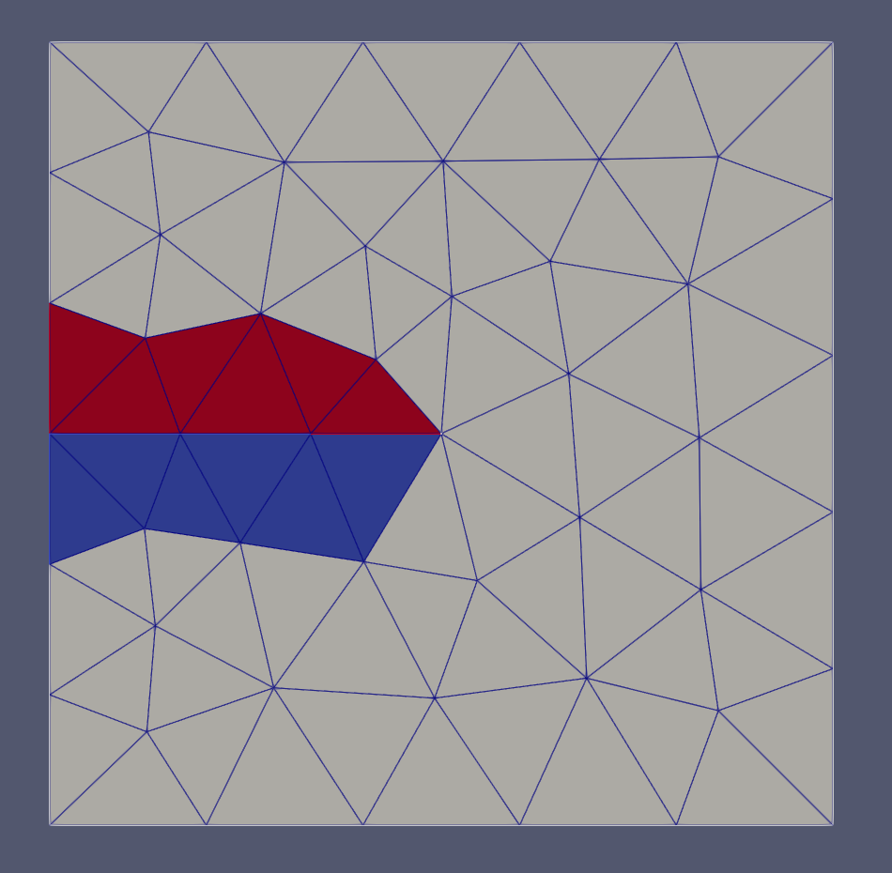
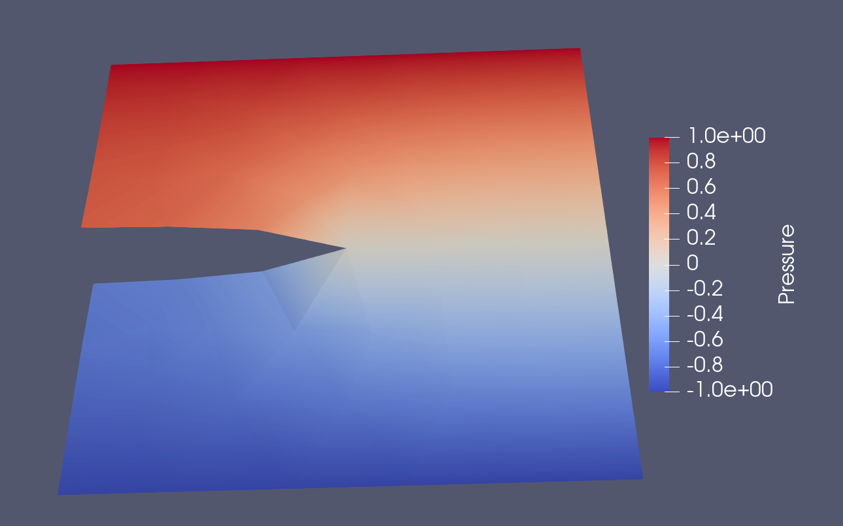
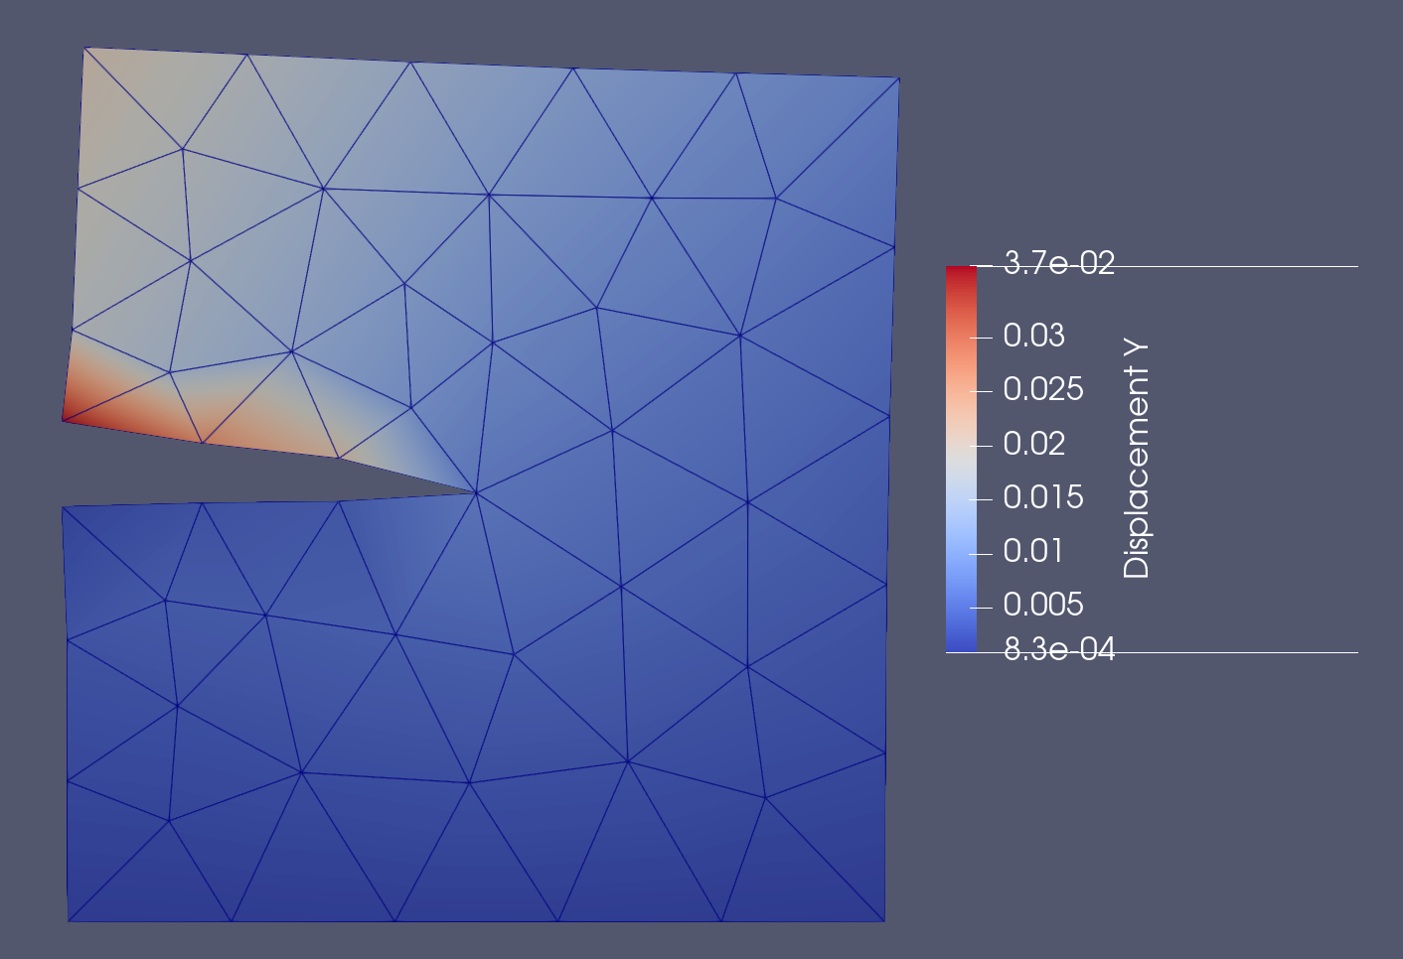
2D simulation
Square domain with mesh aligned fracture
Separating red and blue
elements
Scalar problem
Elasticity problem
No singular functions yet

Slide 12
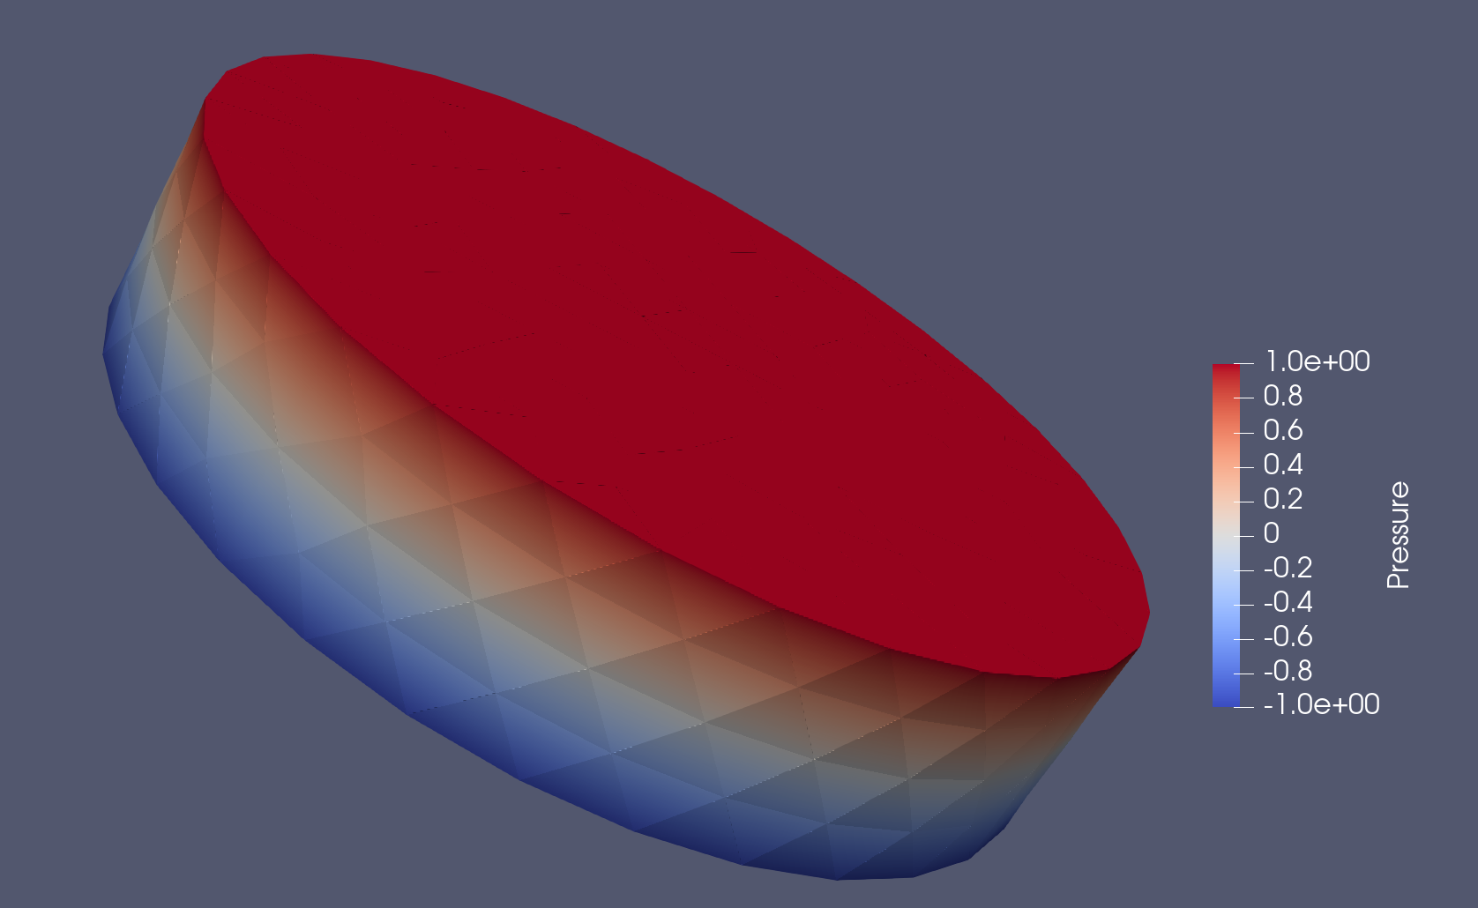
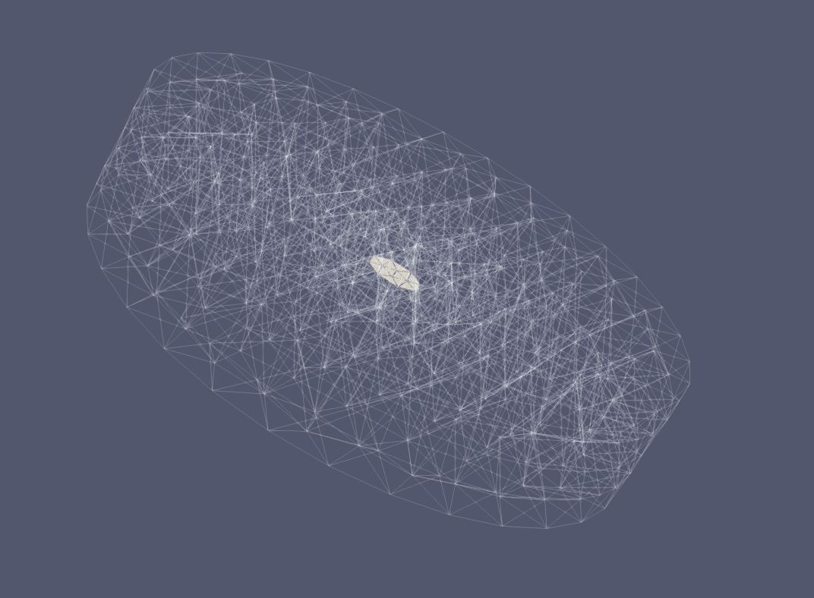
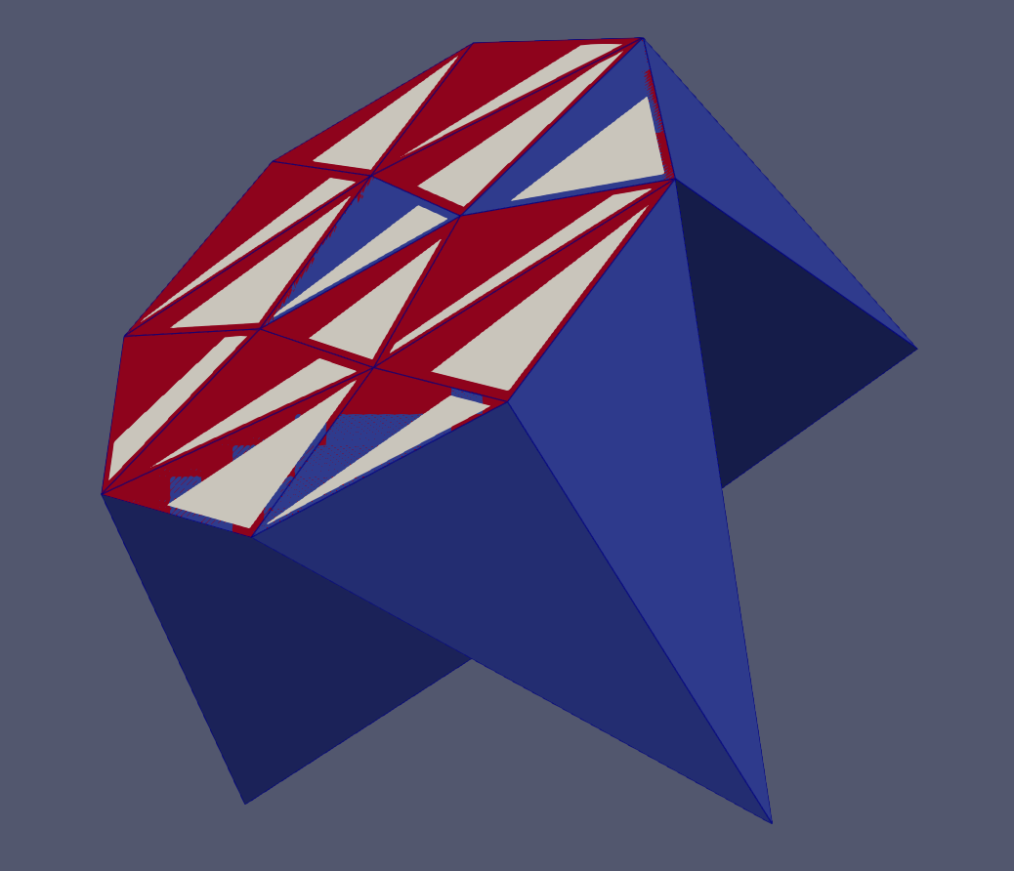
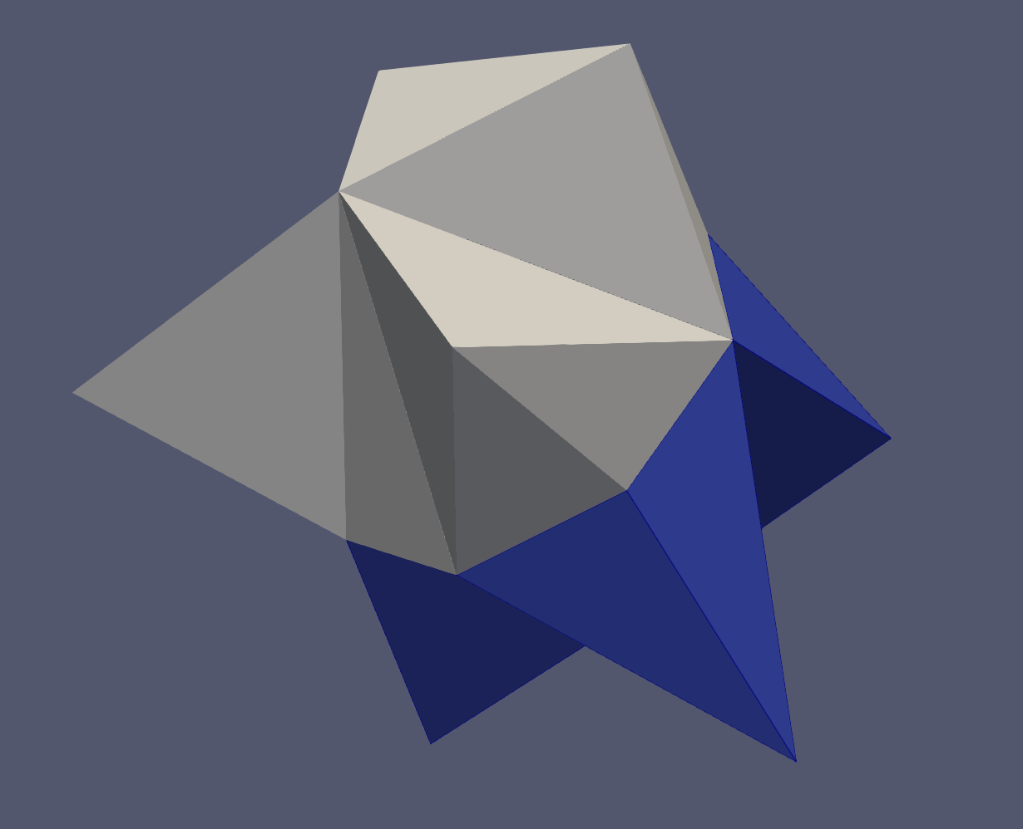
3d simulation
Cilindrical domain with penny shaped internal geometry
Problem setup
Mesh coloring
Gfem elements

Slide 13
Second seminar - overview
Gfem computational mesh and element
Validating the 3D computation
Singular functions
A patch of elements around a Gfem shape function
Condensing internal equations and orthogonality
Using shape function constraints to enrich Gfem functions
Minimum eigenvalues of a patch of elements

Slide 14
Gfem computational mesh/element
Gfem computational mesh derived from TPZCompMesh
Map of connect index and enrichment function
A class the computes the enrichment function
Gfem computational element data structure
A color
Gfem computational element virtual functions
ComputeRequiredData
ComputeShape

Slide 15
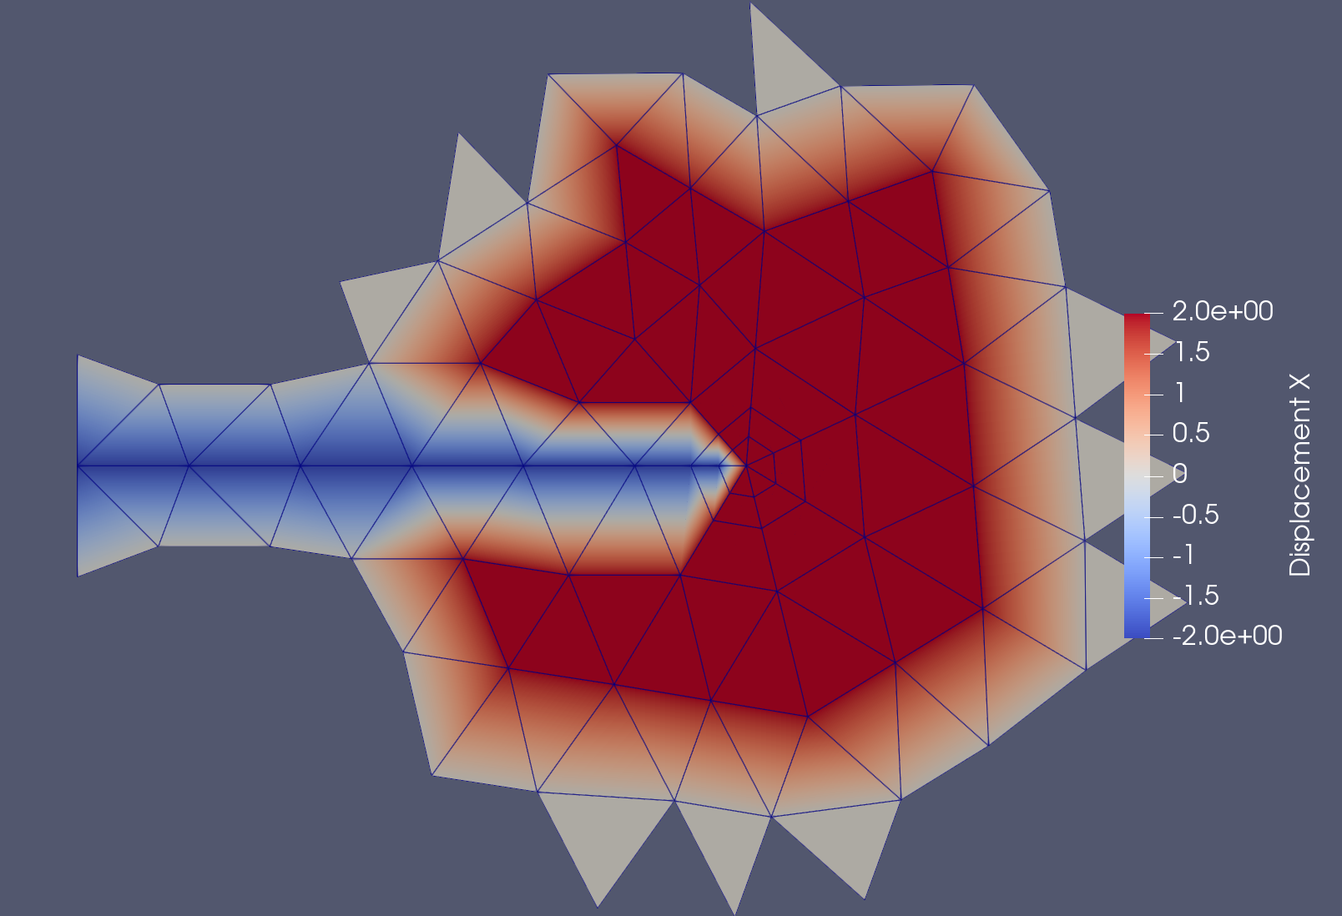
Gfem computational mesh
Gfem elements
Connects and enrichment functons

Slide 16
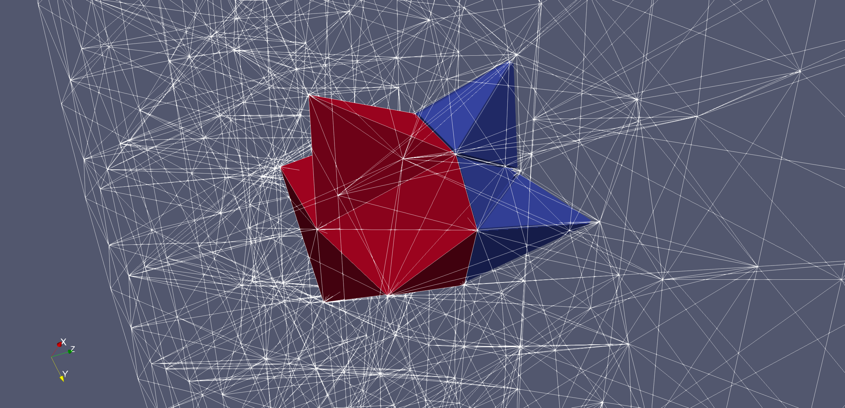
3D Gfem computational mesh
3d Gfem associated with heavyside functions
Singular enrichmeht has not been implemented

Slide 17
Essential Changes do NeoPZ
Shape functions of H1 meshes are traditionally scalar
In Gfem shape functions are vectorial
ComputeRequiredData -> changes the nature of shape functions to scalar
ComputeShape -> changes the nature of shape functions to vectorial and multiplies them with enrichment functions
Variational statement (material) was extended to handle
vectors of shape functions
Scalar and vector values shape functions

Slide 18
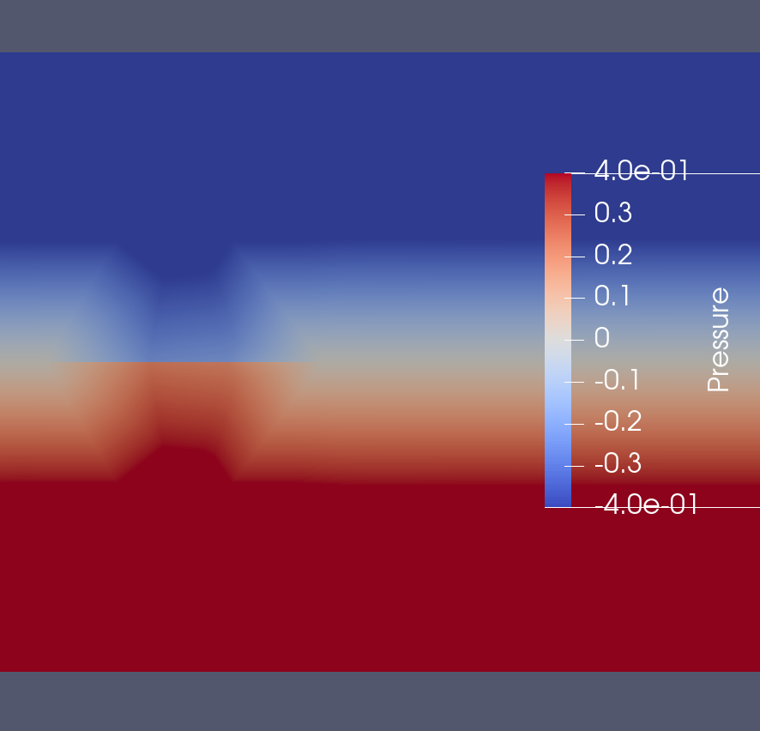
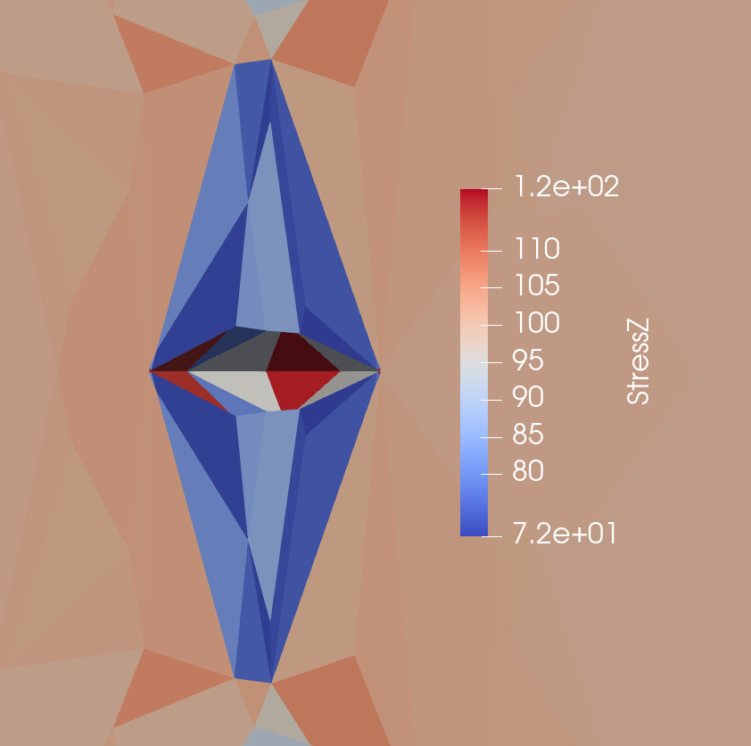
2D and 3D validation
Gfem without singular enrichment and aligned meshes correspond to H1 discontinuous approximations

Slide 19
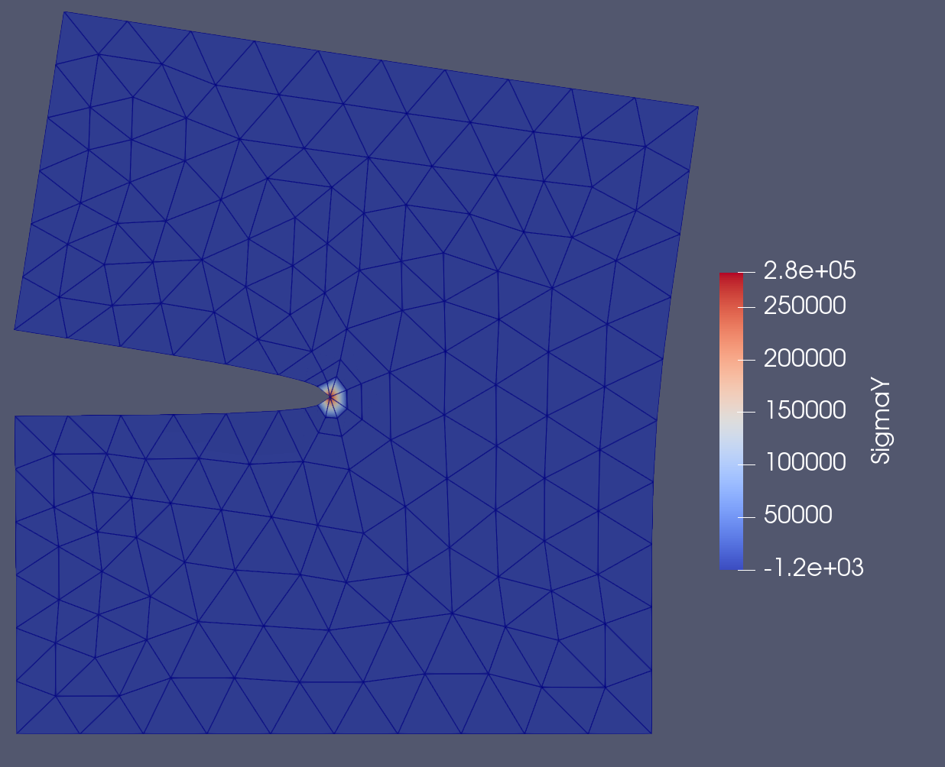
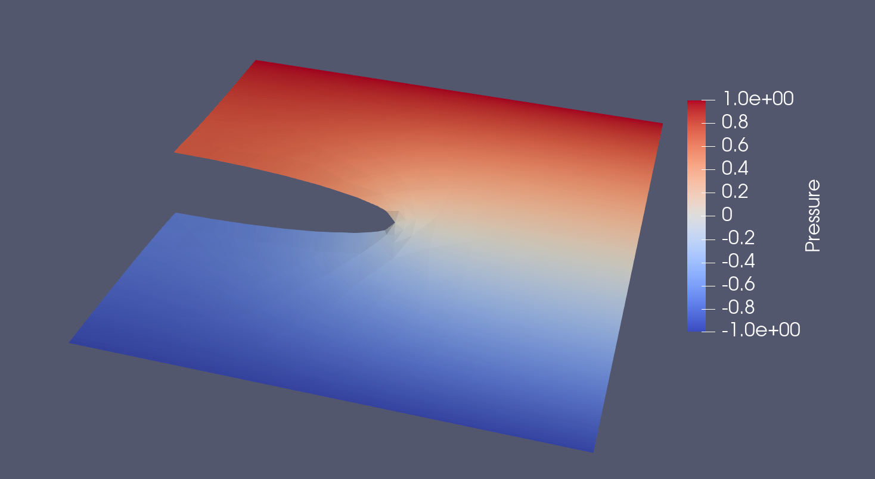
2D Gfem with enrichment
Approximations “look” better

Slide 20
Patch of elements
Around each Gfem node
a patch of elements can be identified
Internal nodes/equations
The Gfem shape function is fully connected to the H1 functions

Slide 21
H1 functions Gfem functions
Ordering first H1 functions and then Gfem functions, the matrix of the internal equations of the patch can be written as
If the Gfem functions is linearly dependent on the H1 functions then this matrix if singular or has very small eigenvalue(s)
H1 functions
Gfem functions

Slide 22
Some linear algebra concepts
Let
KG be the global matrix
KS be a matrix extracted from the global matrix
Then
The smallest eigenvalue of a patch is an upper bound for the minimum eigenvalue of the global matrix

Slide 23
Orthogonality of a vector
Partition a vector
Extend an arbitrary v1 as
Then

Slide 24
Computing the matrix of the patch
Using the extended vector
The patch matrix becomes
The smallest eigenvalue of the scaled patch matrix is up to 13000 larger than the smallest eigenvalue of the original patch

Slide 25
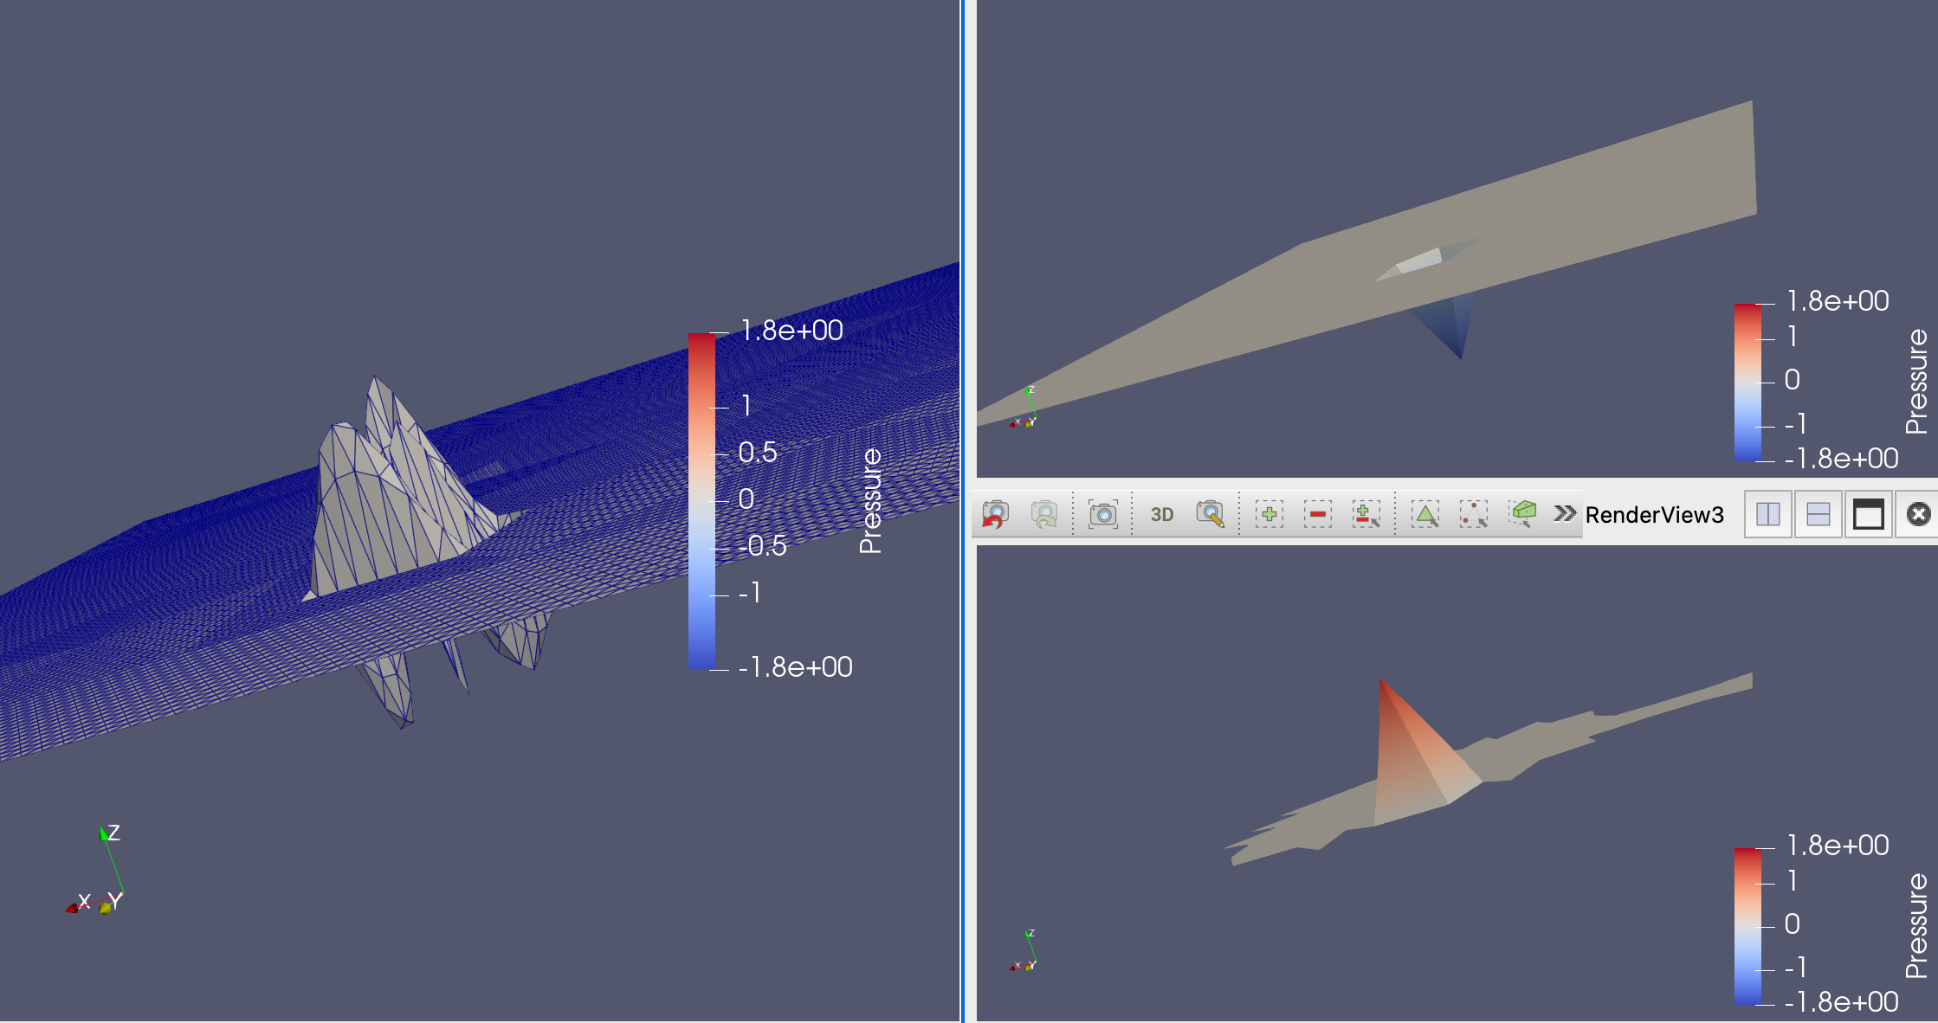
Modified Gfem basis function
- best H1 projection
Modified Gfem function
+
[v1]
Amplified 300 times!
original Gfem function

Slide 26
Conclusion
A minimal data structure extension was needed for NeoPZ
Std::function was used to define/implement the enrichment functions
Static condensation was applied to orthogonalize the enrichment functions w.r.t. the H1 function at the patch level
Huge improvements were observed in condition number
The minimum eigenvalue may determine if the enrichment is necessary/beneficial

